Slide 1
In the news
Fast-food CEO says 'it just makes sense' to consider replacing cashiers with machines

Slide 2
In the news
Walmart/Asda Officials Plan To Cut Thousands Of Jobs Through Store Closures, Automation … facilities that have no cashiers.

Slide 3
In the news
Bill Gates thinks AI taking everyone's jobs could be a good thing - there isn't a lot we can do to stop it.

Slide 4
In the news
Why Automation is Different This Time - "there is no sector of the economy left for workers to switch to“
“as mechanical muscles pushed horses out of the economy, mechanical minds will do the same to humans. Not immediately, not everywhere, but in large enough numbers and soon enough that it’s going to be a huge problem if we are not prepared. And we are not prepared”

Slide 5
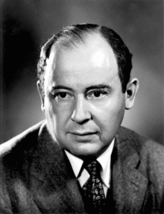
John von Neumann

Slide 6
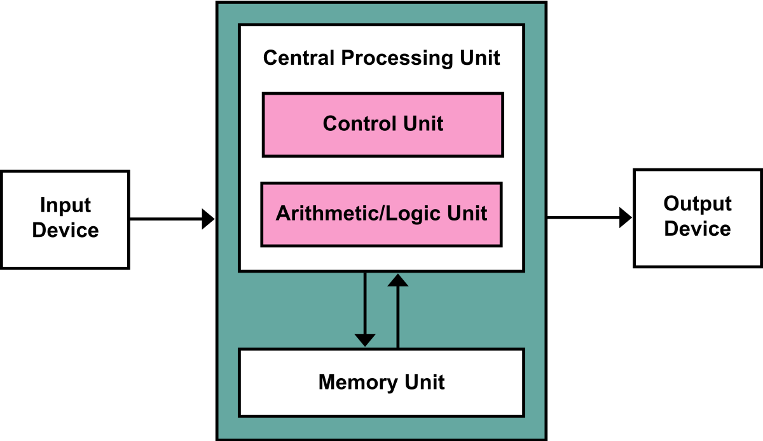

Slide 7
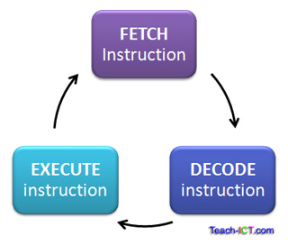
What is the purpose of the cpu?
The CPU executes programs (made up of instructions) using the fetch-decode-execute cycle

Slide 8
Fetch – decode – execute
The CPU fetches an instruction
The CPU decodes the instruction to determine what action is required
The CPU then executes that instruction
This cycle is repeated once every clock cycle, therefore the clock speed determines how fast the instructions are executed by the computer

Slide 9
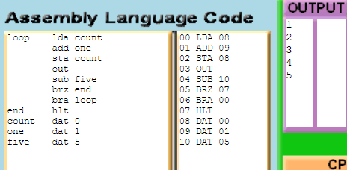
Labels and dat

Slide 10
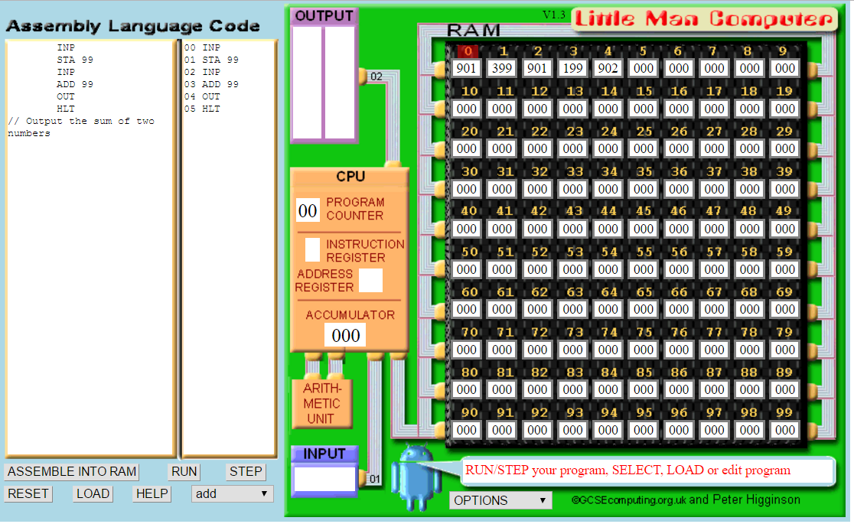

Slide 11
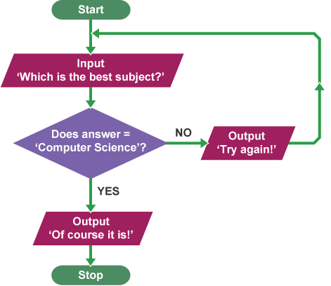
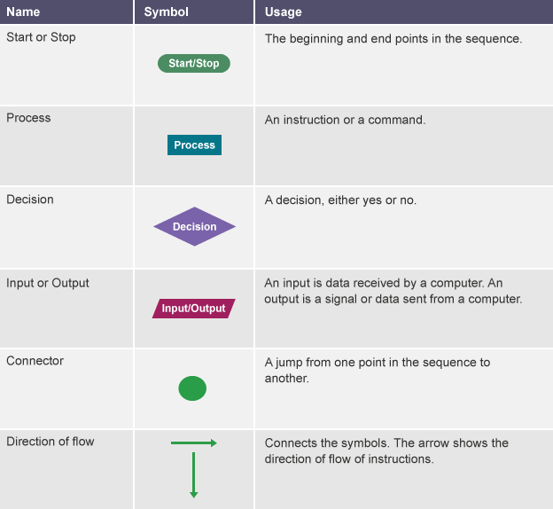
Flow charts

Slide 12
Little man computer
Input two numbers, add them, display result
Input two numbers, minus them, display result
Input two numbers, display the smallest
Input a number, count down to zero
Input two numbers and multiply them
Input a number, output the cube (n*n*n)
Output all odd numbers less than 100
Screen shots
Document little man computer
Document your code
Flow charts
Screen shot the code working

Slide 13
Little man computer – extension tasks
Investigate labels (see max program for an example) what is happening?
Write a program that divides two numbers – assume the user will input numbers that divide with no remainder.
Write a program that divides two numbers, output result and remainder
Allow the user to input 3 numbers output them sorted
Screen shots
Document little man computer
Document your code
Flow charts
Screen shot the code working

Slide 14
http://www.yorku.ca/sychen/research/LMC/

